Slide 1

Data Analysis for a Product listed on Amazon
Team Name : P119 , Group-1
G. Savithri Mani
Sunil Dharmaraj More
Aboli Anil Hagone
Shubham Thube
Ashutosh Dnyandev Dhake
Sagar Bharat Parsewar
Parul Yadav
Mentor : Rajshekhar
Date : 13/05/2022

Slide 2
Business Objective :
Need to get daily Analysis of a product such as emotions, sentiment etc. using Amazon data.

Slide 3
Project Architecture :
Data Collection
Data Pre-Processing
EDA
Data Visualization
Model Building
Model Evaluation
Model Deployment

Slide 4
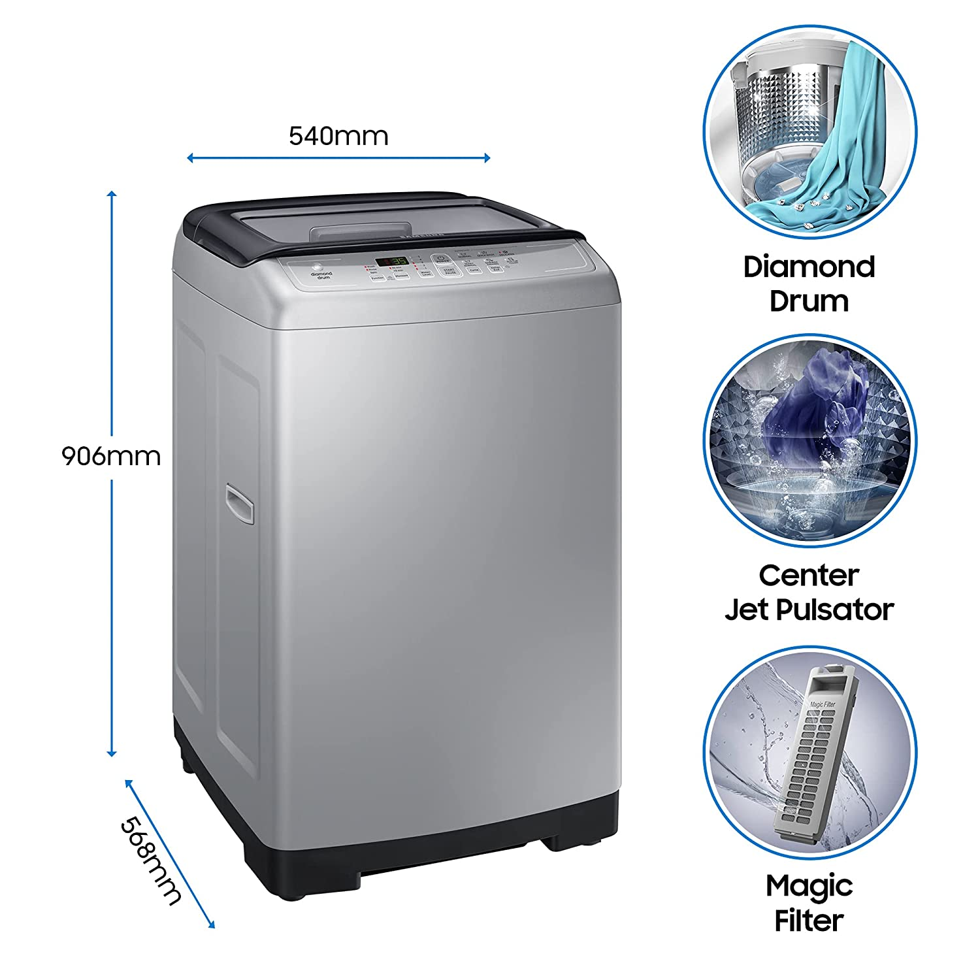
Product Details :
Samsung 6.5 kg Fully-Automatic Top Loading Washing Machine (WA65A4002VS/TL, Imperial Silver, Diamond Drum)

Slide 5
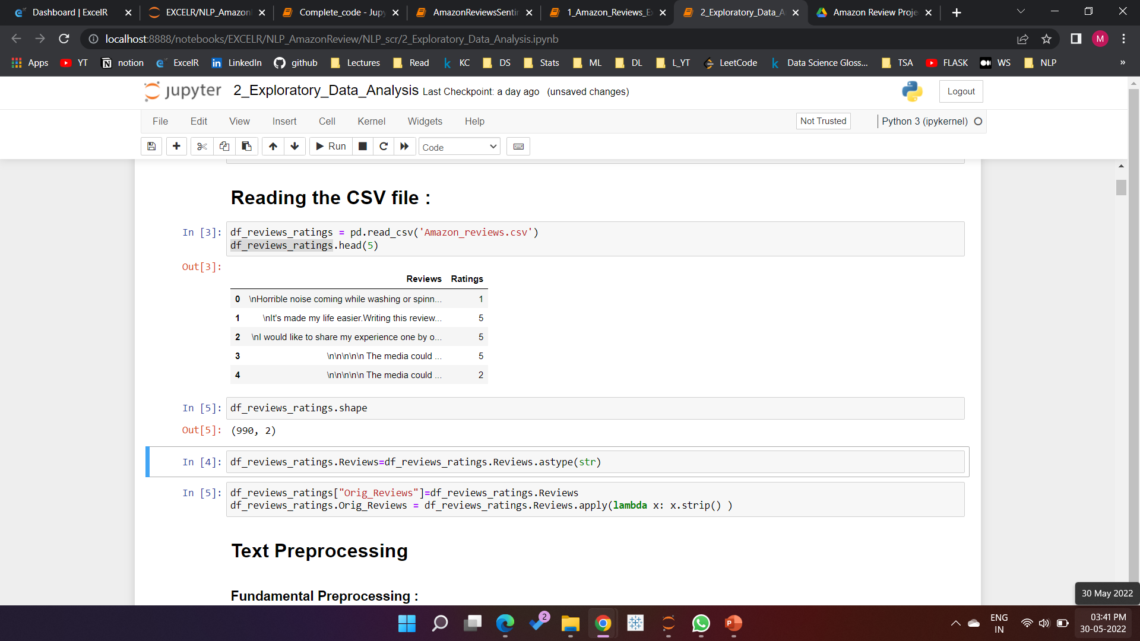
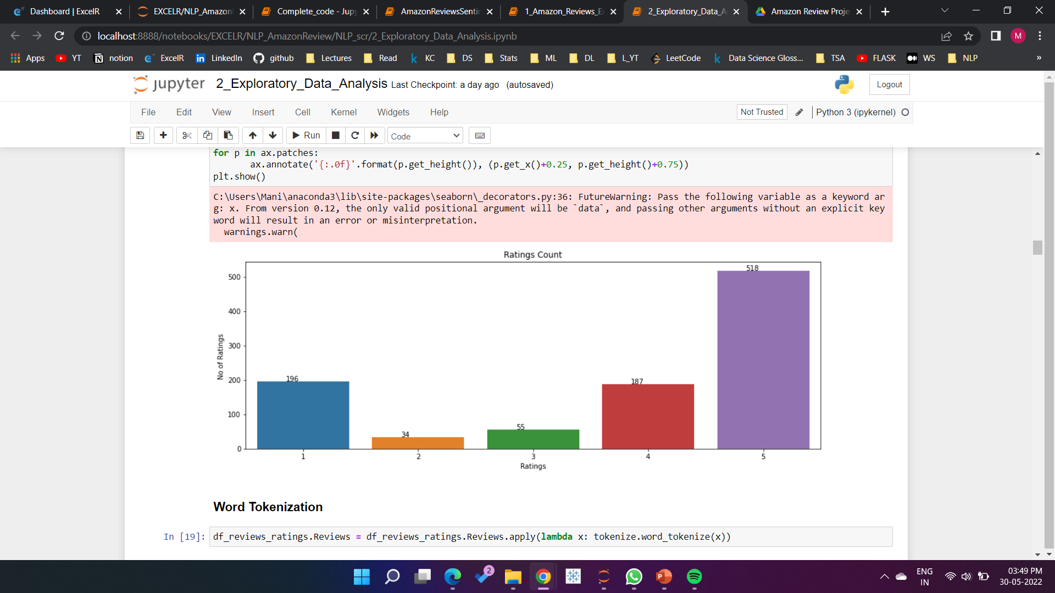
Data Collection
We have used Selenium and beautifulsoup to extract reviews and ratings from the website.
Shape of the data : ( 990 , 2 )

Slide 6

Data Pre-Processing
Converting all text to lowercase
Removing Punctuation
Removing URLs
Removing Usernames from data
Removing other characters except for alphabets and space
Removing Spaces from Start and end
Word Tokenization
Removal of Stop Words
Lemmatization

Slide 7
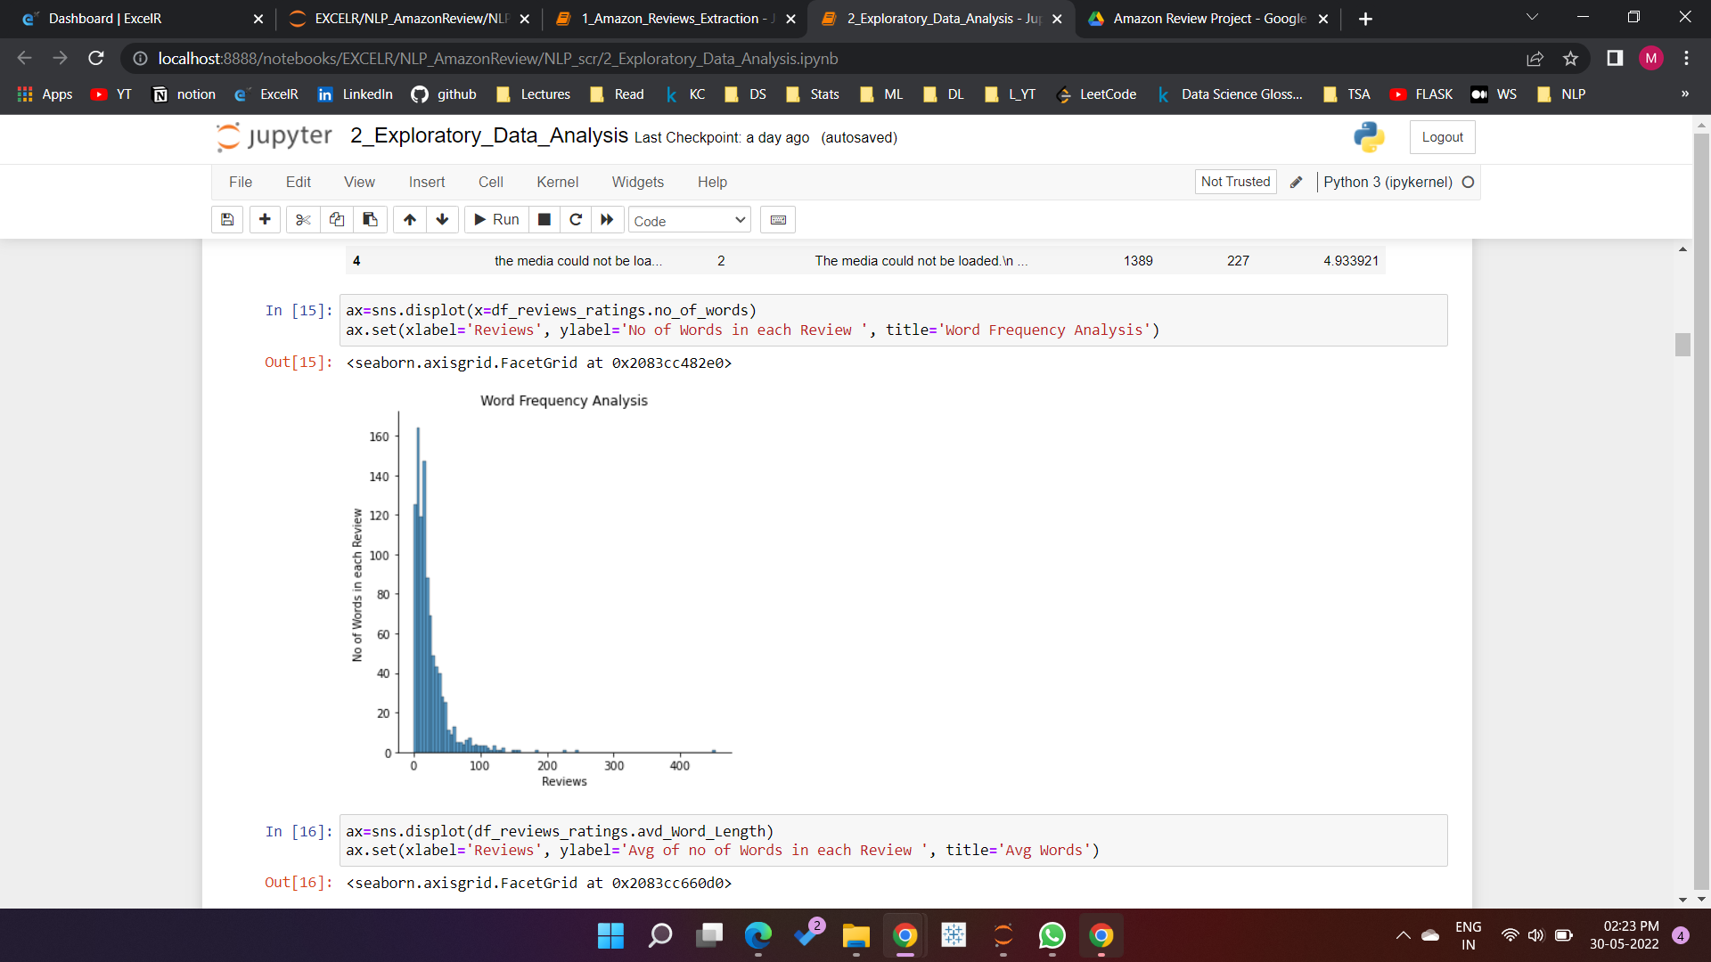
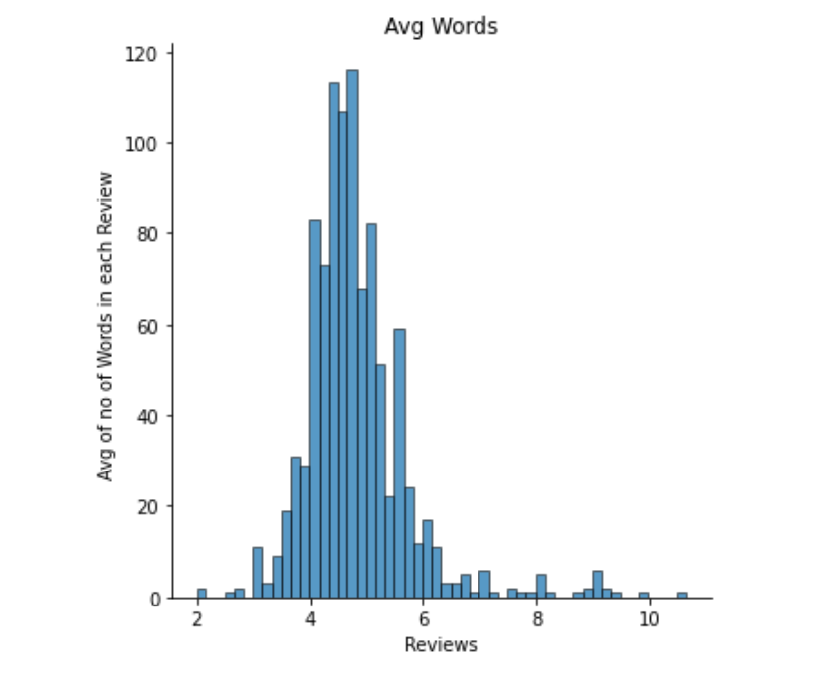
Exploratory Data Analysis
Number of Words: how many words there are in the review.
Average Word Length: average number of letters in the words in a review.
Number of characters: how many letters are contained in the review.

Slide 8
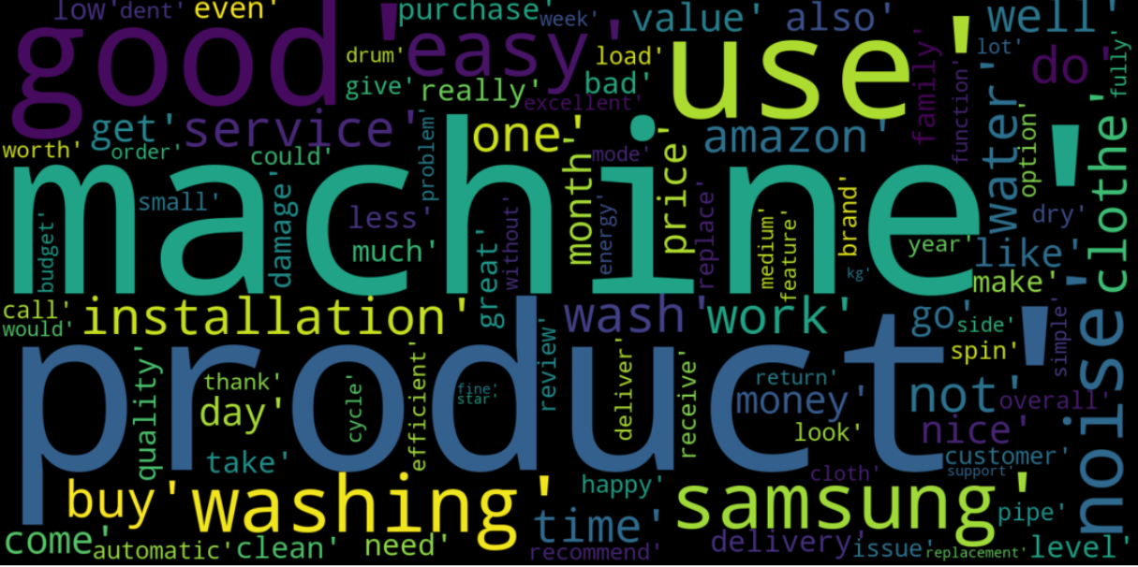
Word Clouds :
Top 100 Most Repeated Words

Slide 9
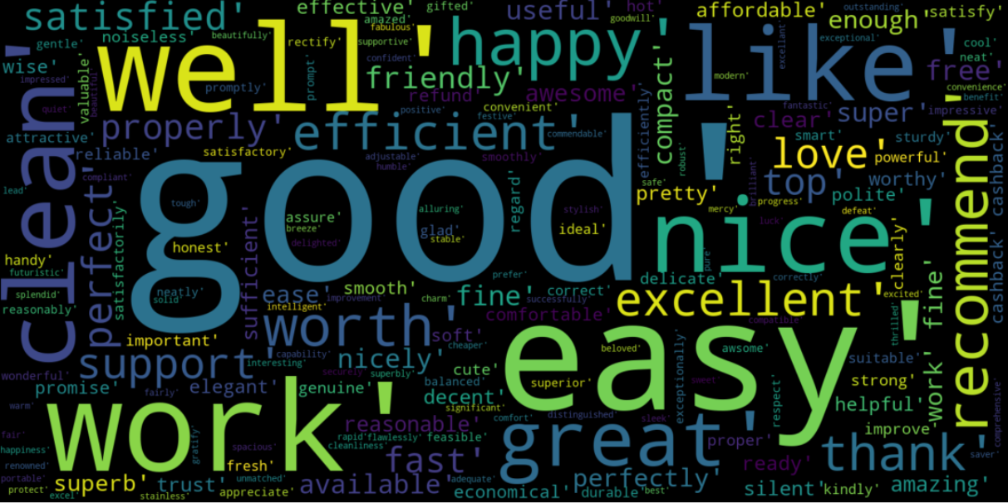
Positive Word Cloud

Slide 10
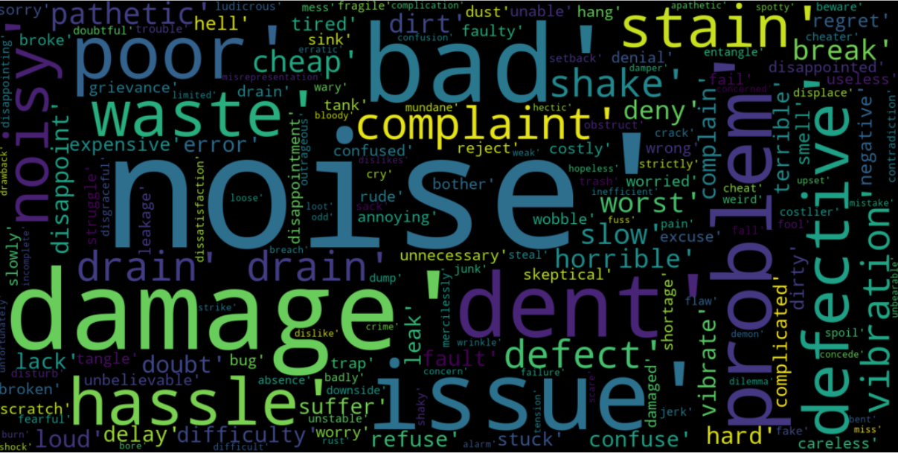
Negative Word Cloud

Slide 11
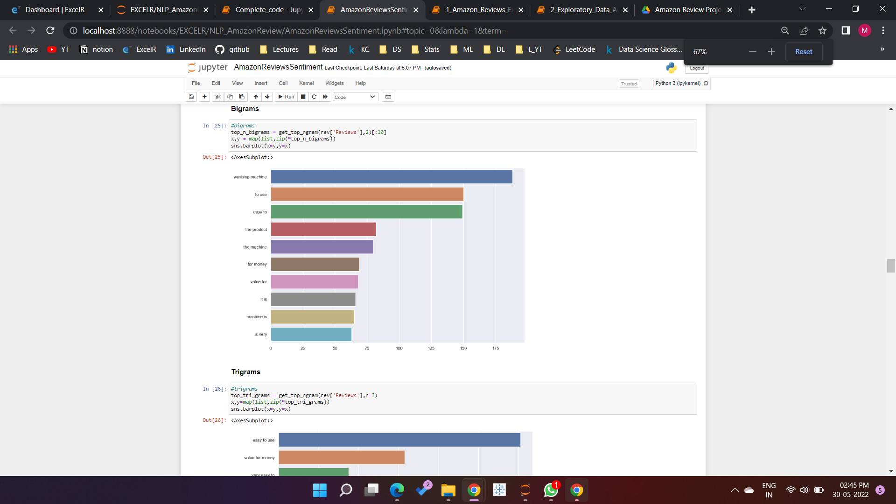
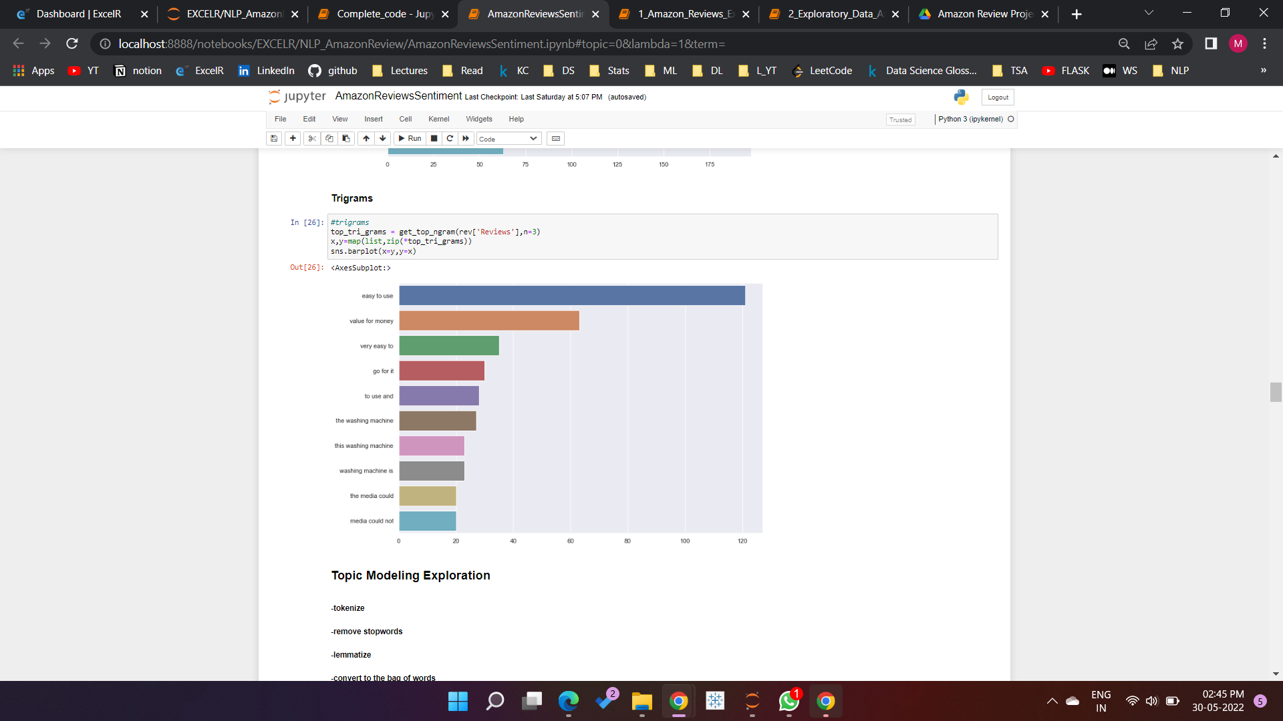
Ngrams :
Top 10 bigrams :
Top 10 trigrams :

Slide 12
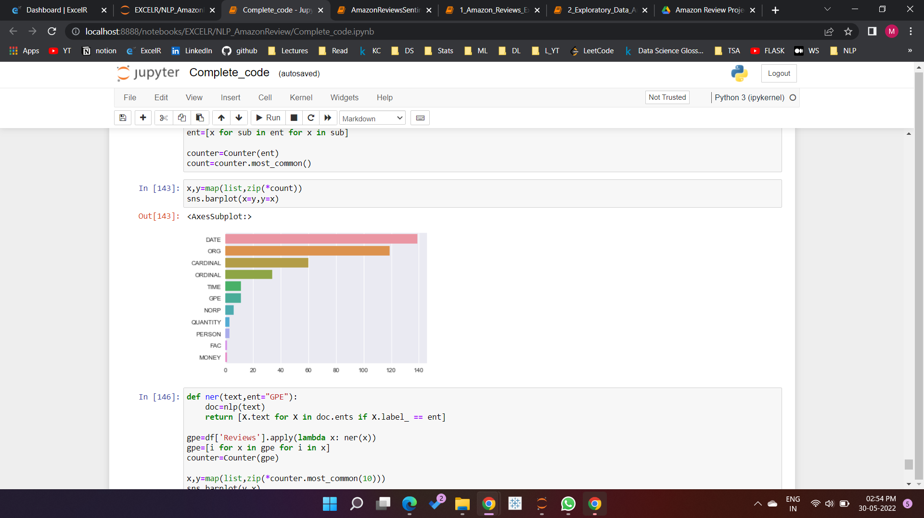
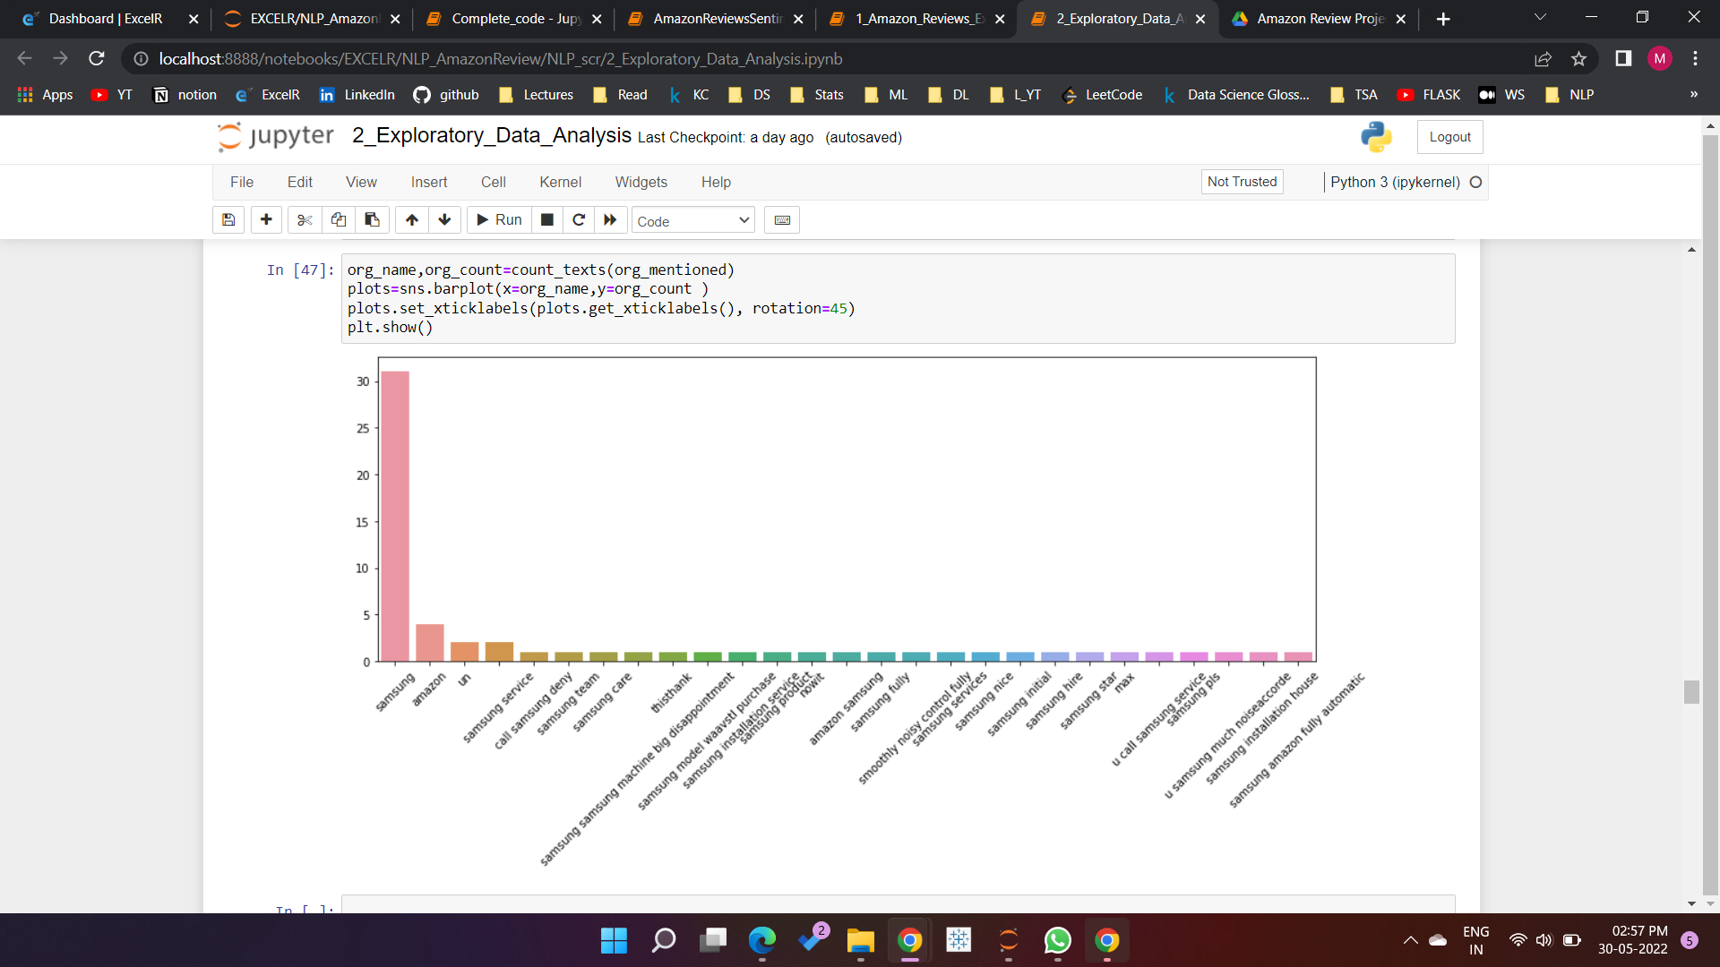
Named Entity Recognition :

Slide 13
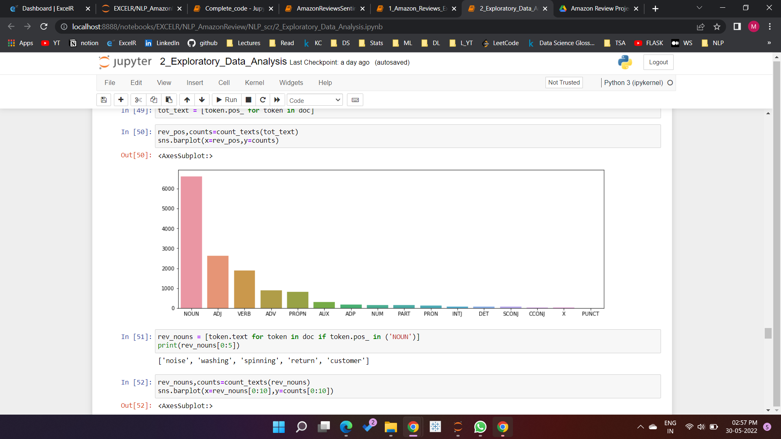
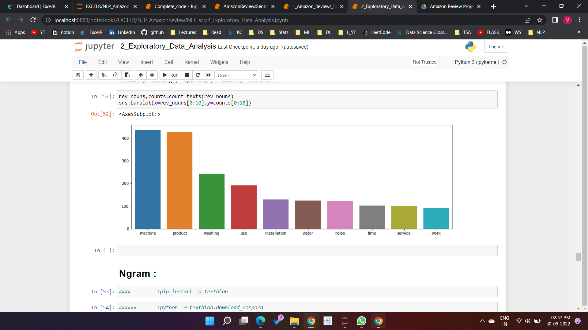
Parts of Speech Tagging :

Slide 14
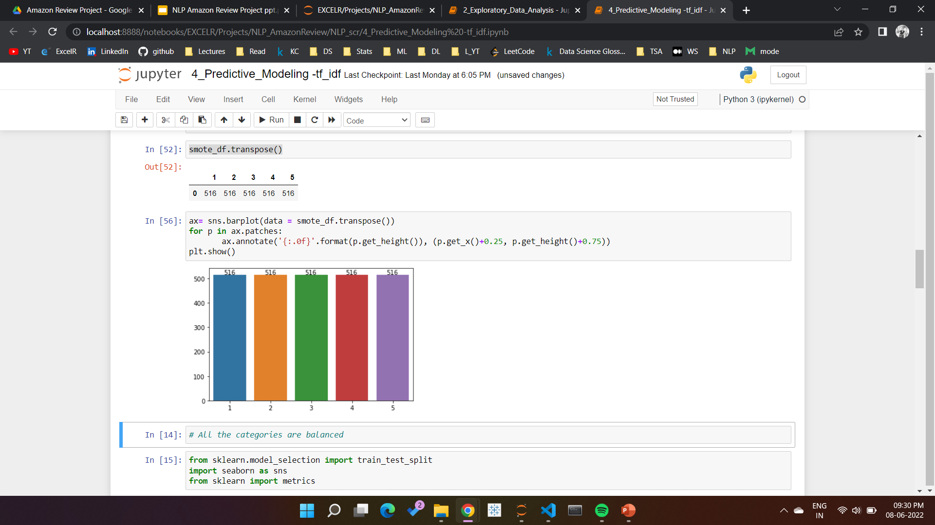
SMOTE
Since the data is imbalance , used SMOTE to balance the data for further modeling.
Used TF-IDF for word embedding .

Slide 15
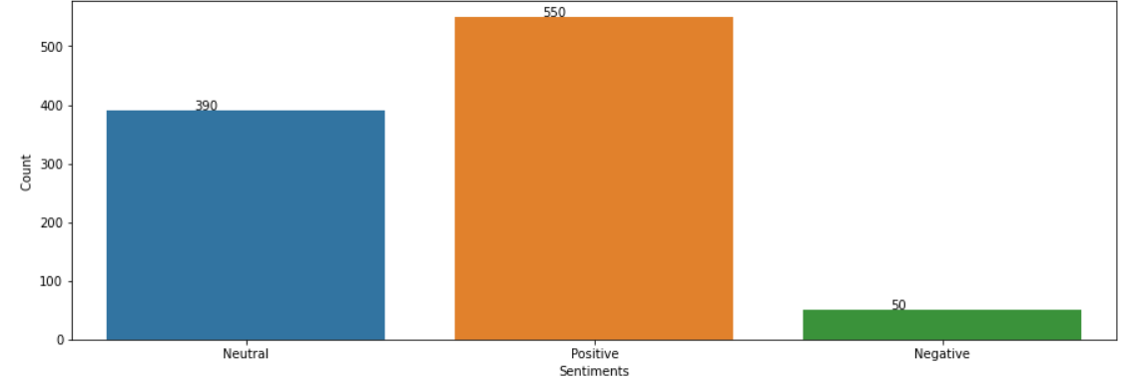
Sentiment Analysis using TextBlob:
Calculated Sentiment analysis using TextBlob
Positive : Polarity > 0.25
Negative : Polarity <0.25
Neutral : 0.25 < Polarity > 0.25

Slide 16
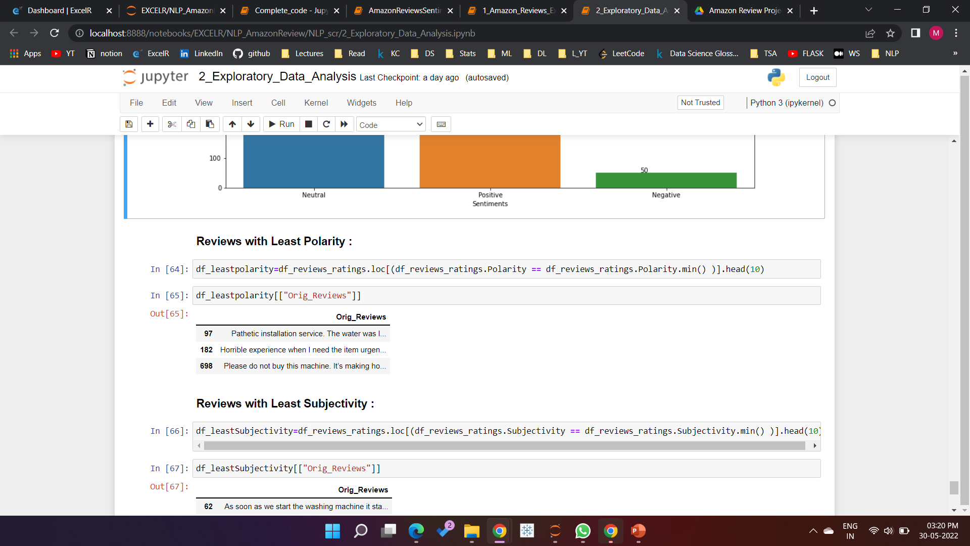
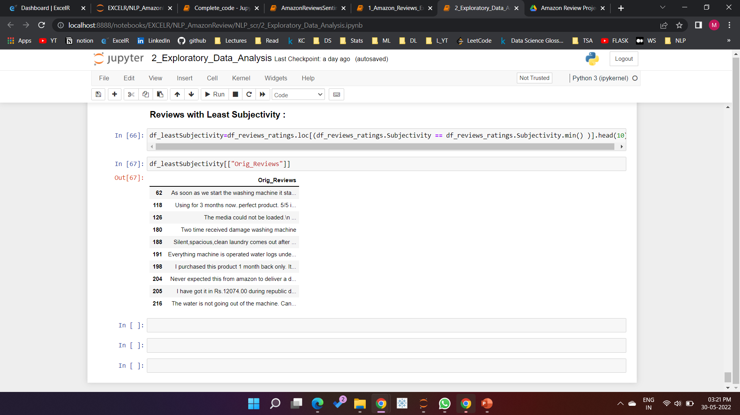
Reviews with least positivity :
Reviews with least subjectivity :

Slide 17
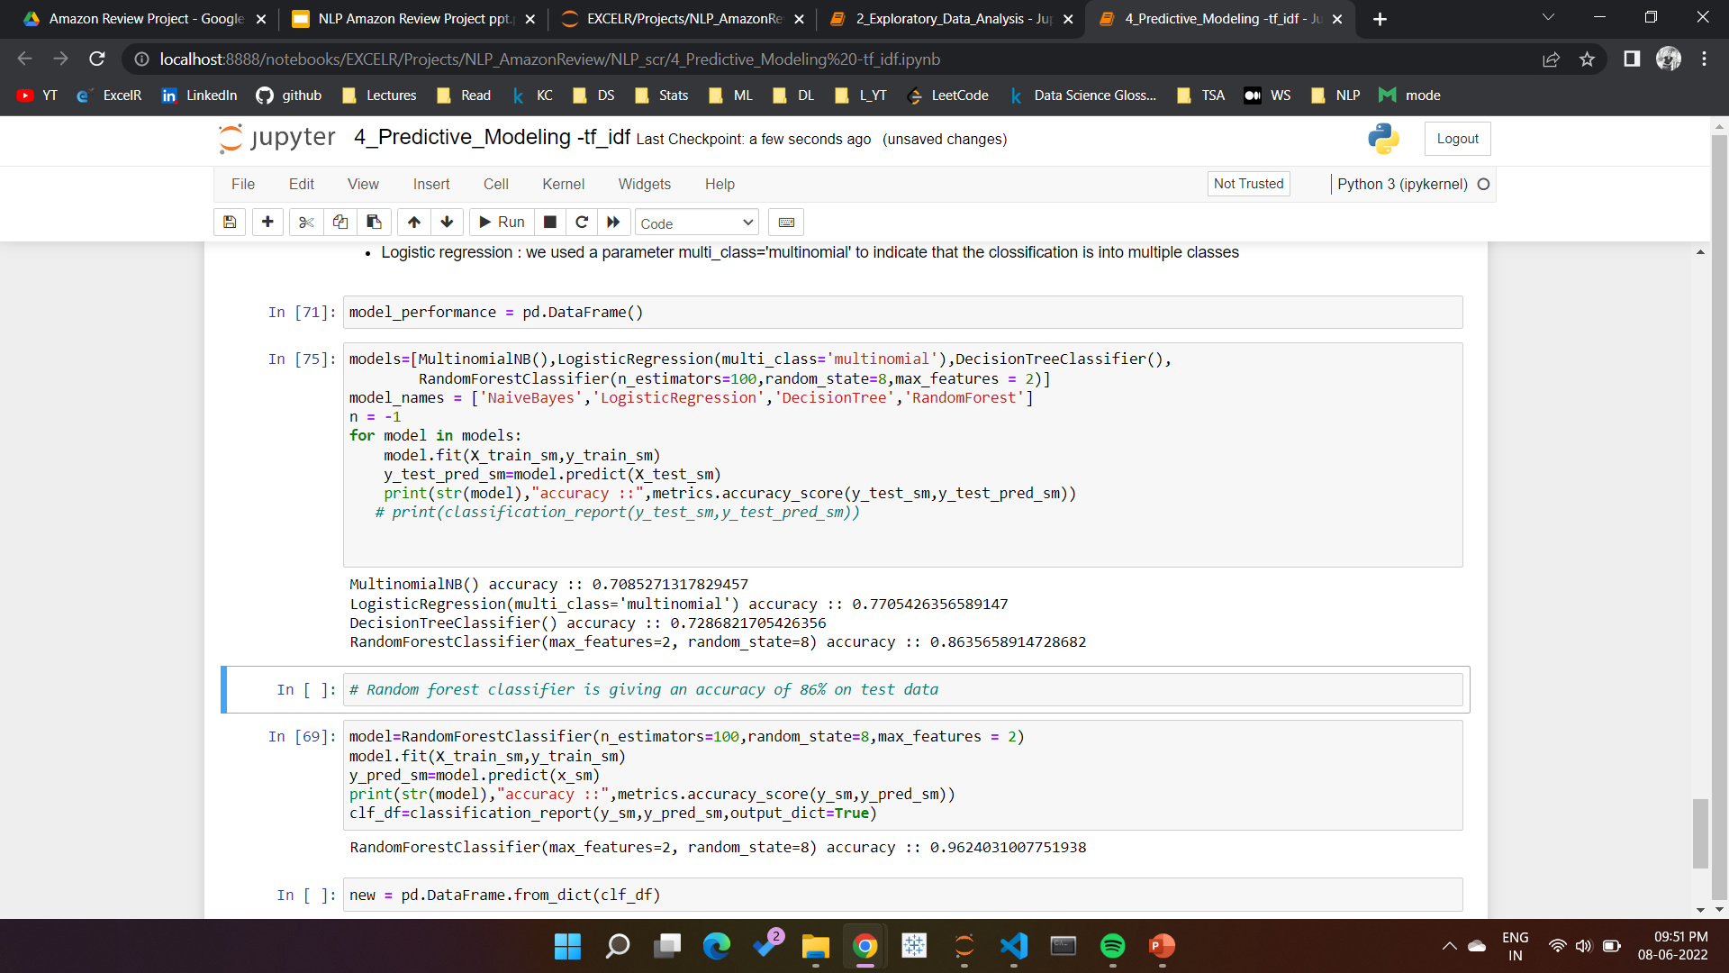
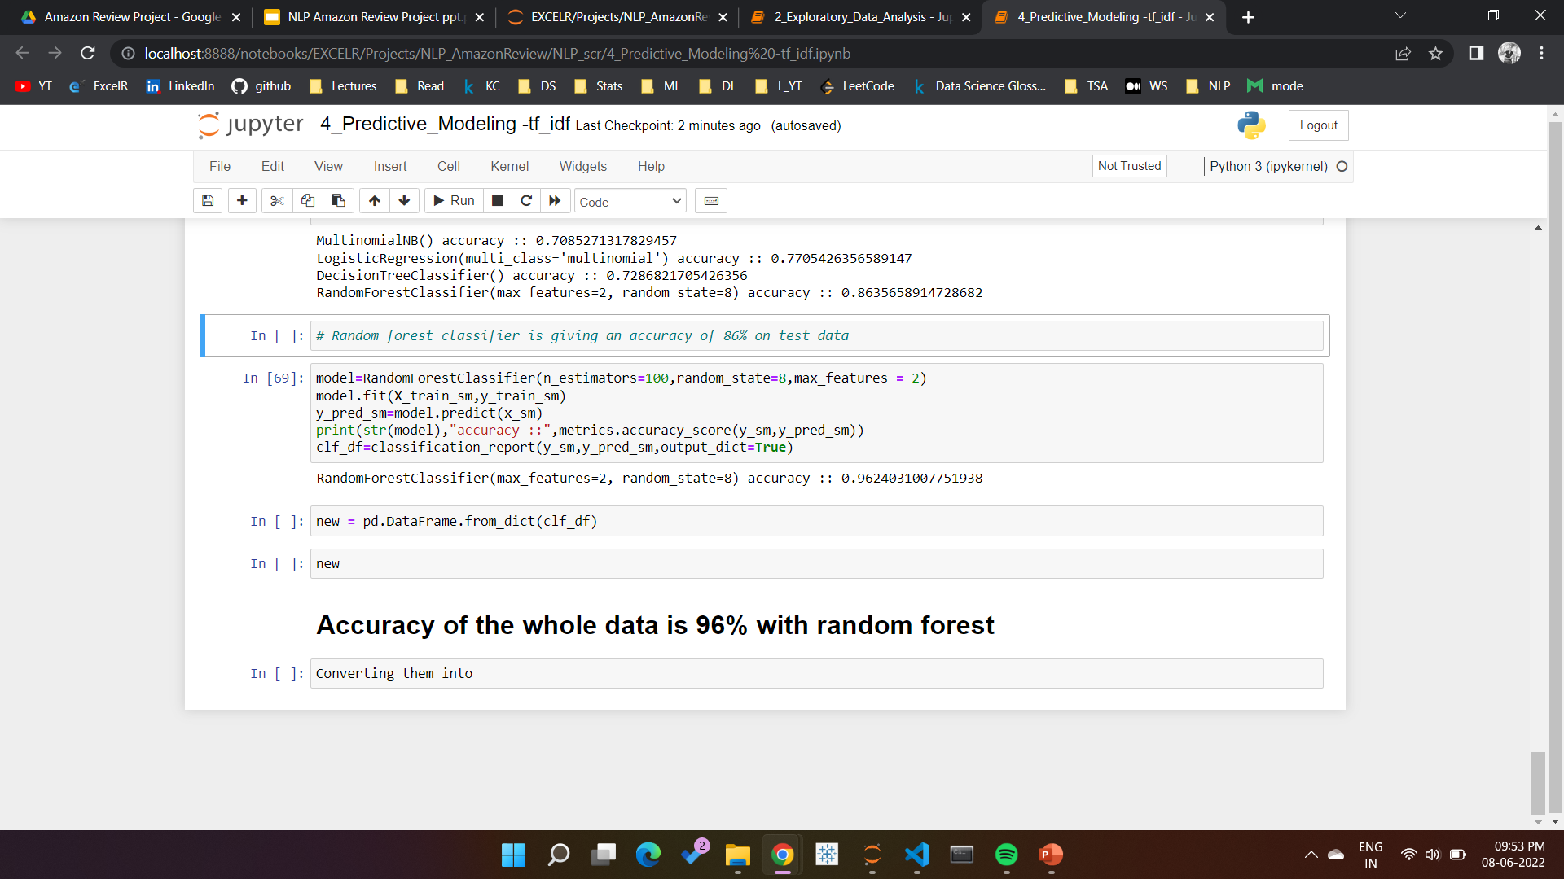
Comparison of Model Performances

Slide 18
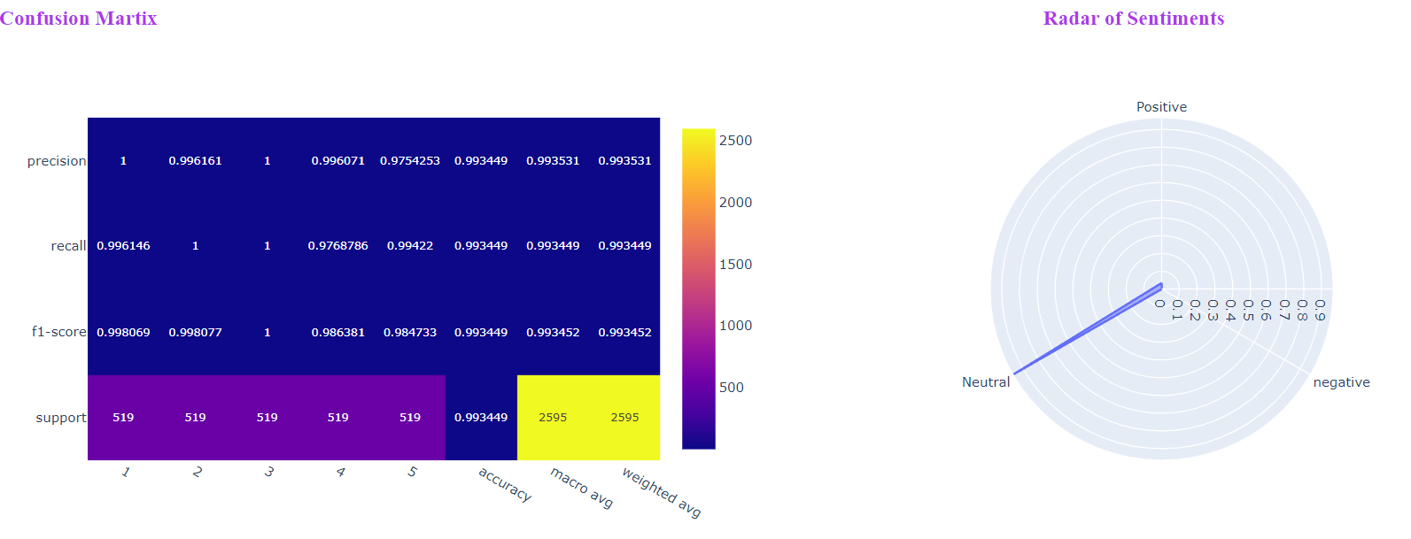
Sentiment Analysis using RandomForest

Slide 19
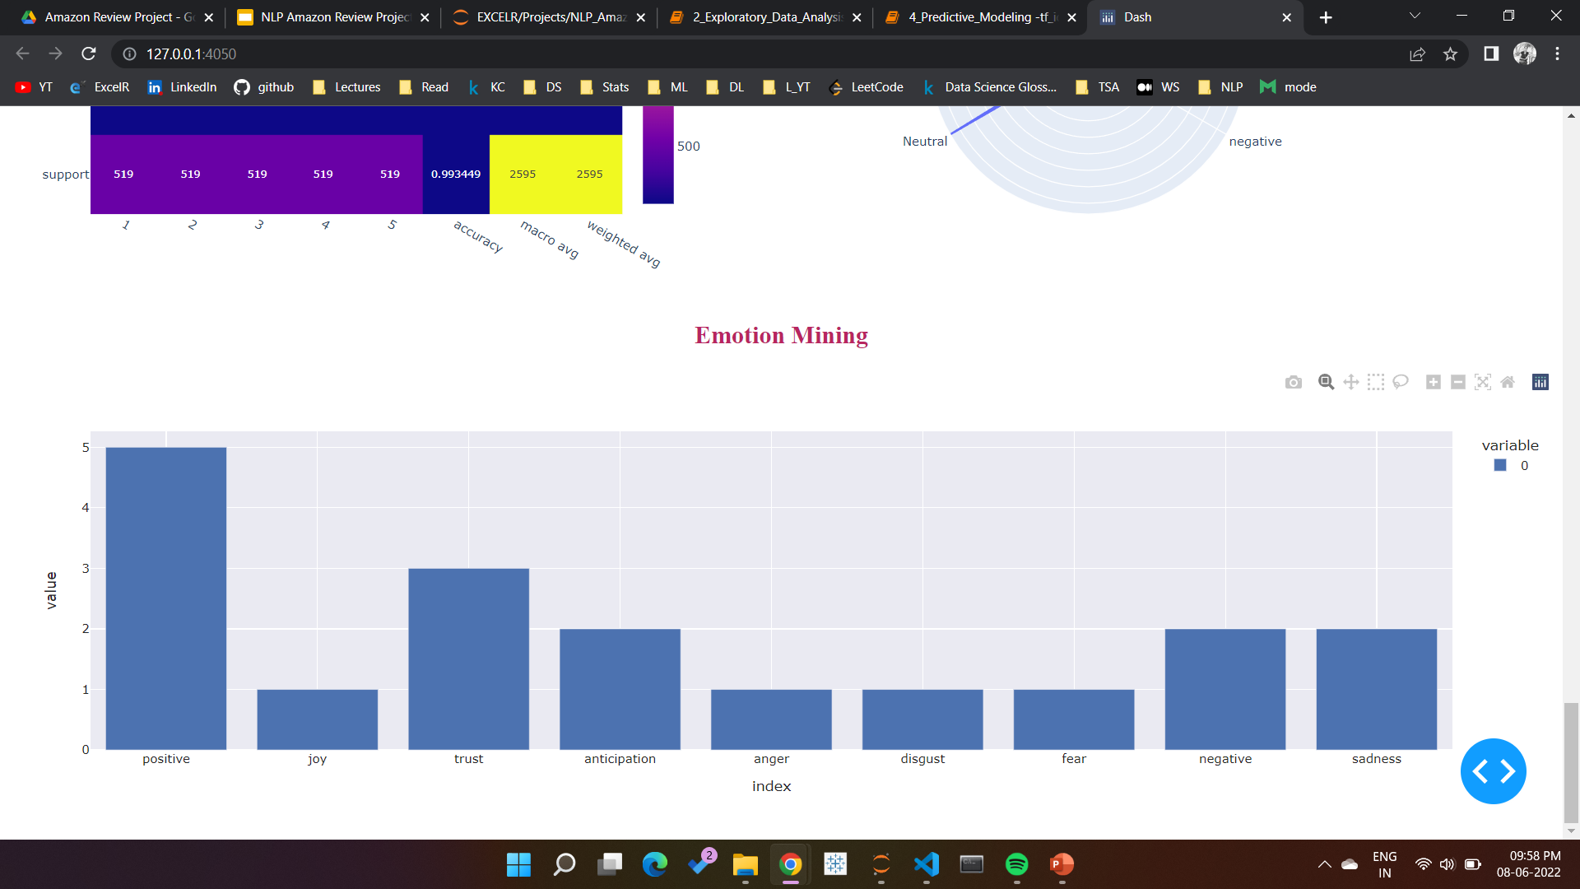
Emotion Mining using NRC Lexicon

Slide 20
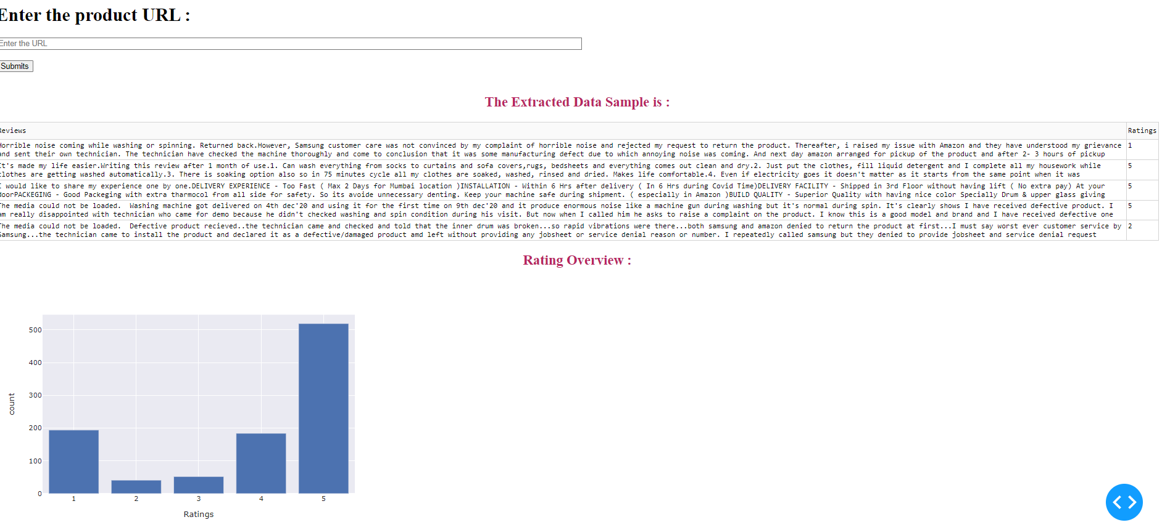
Deployment using DASH

Slide 21
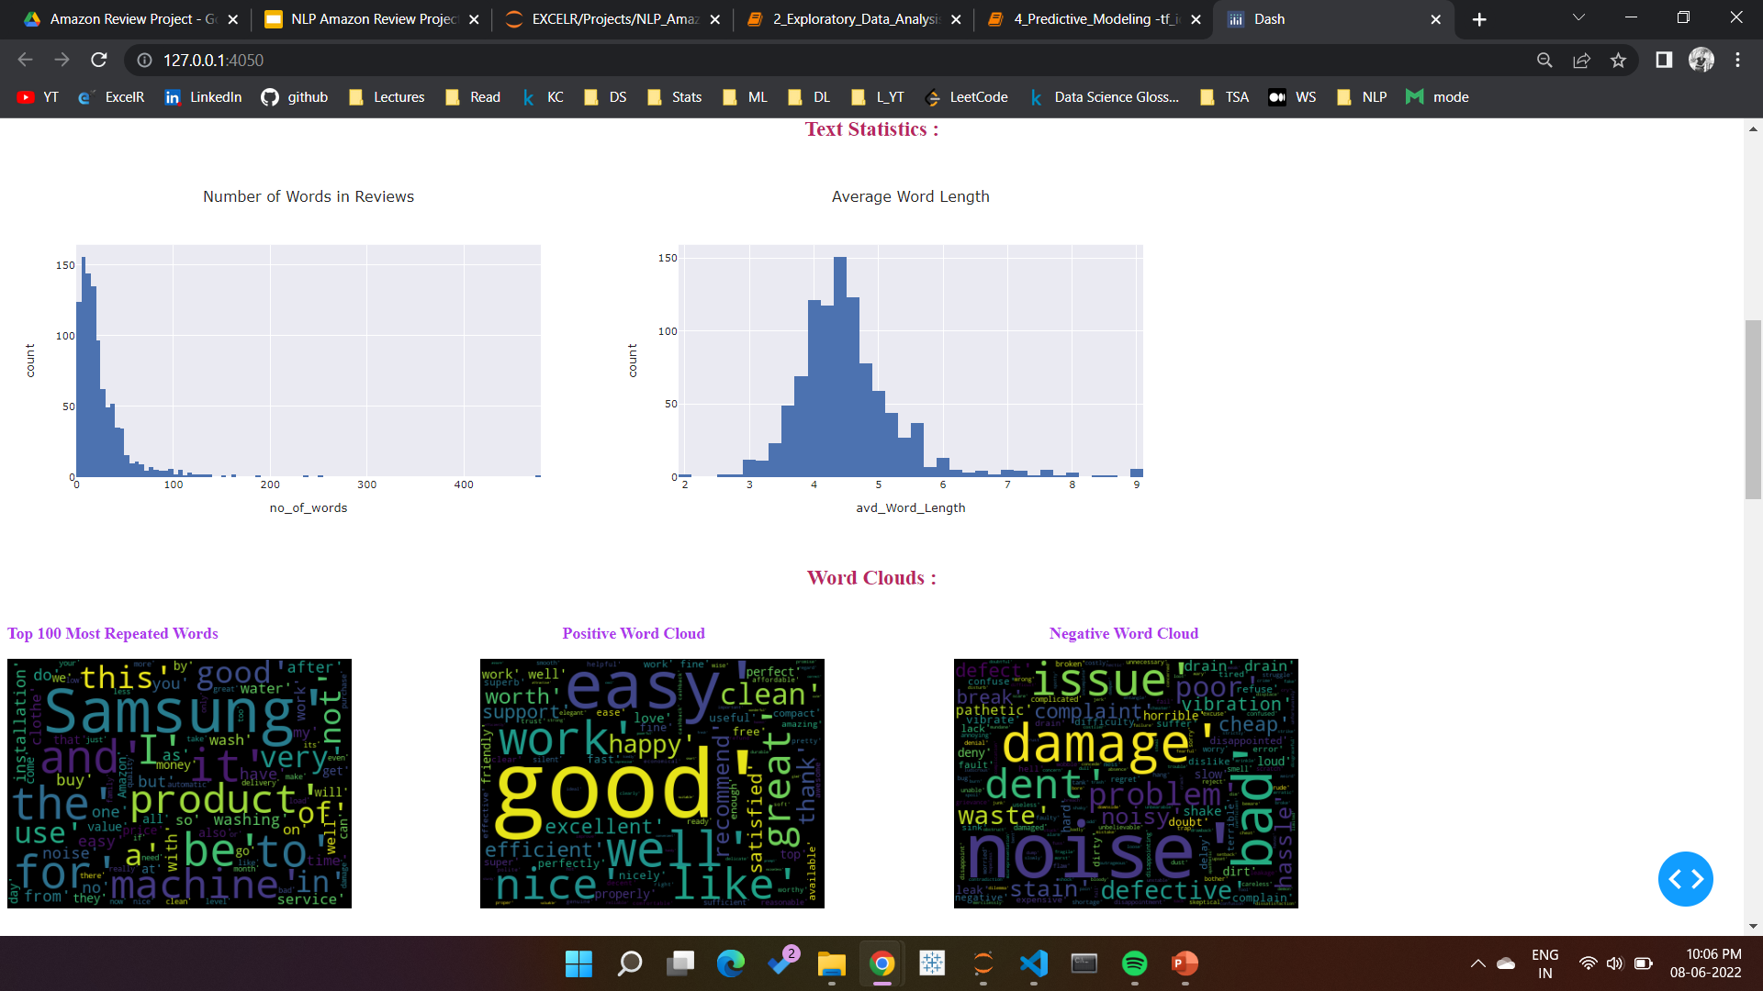

Slide 22
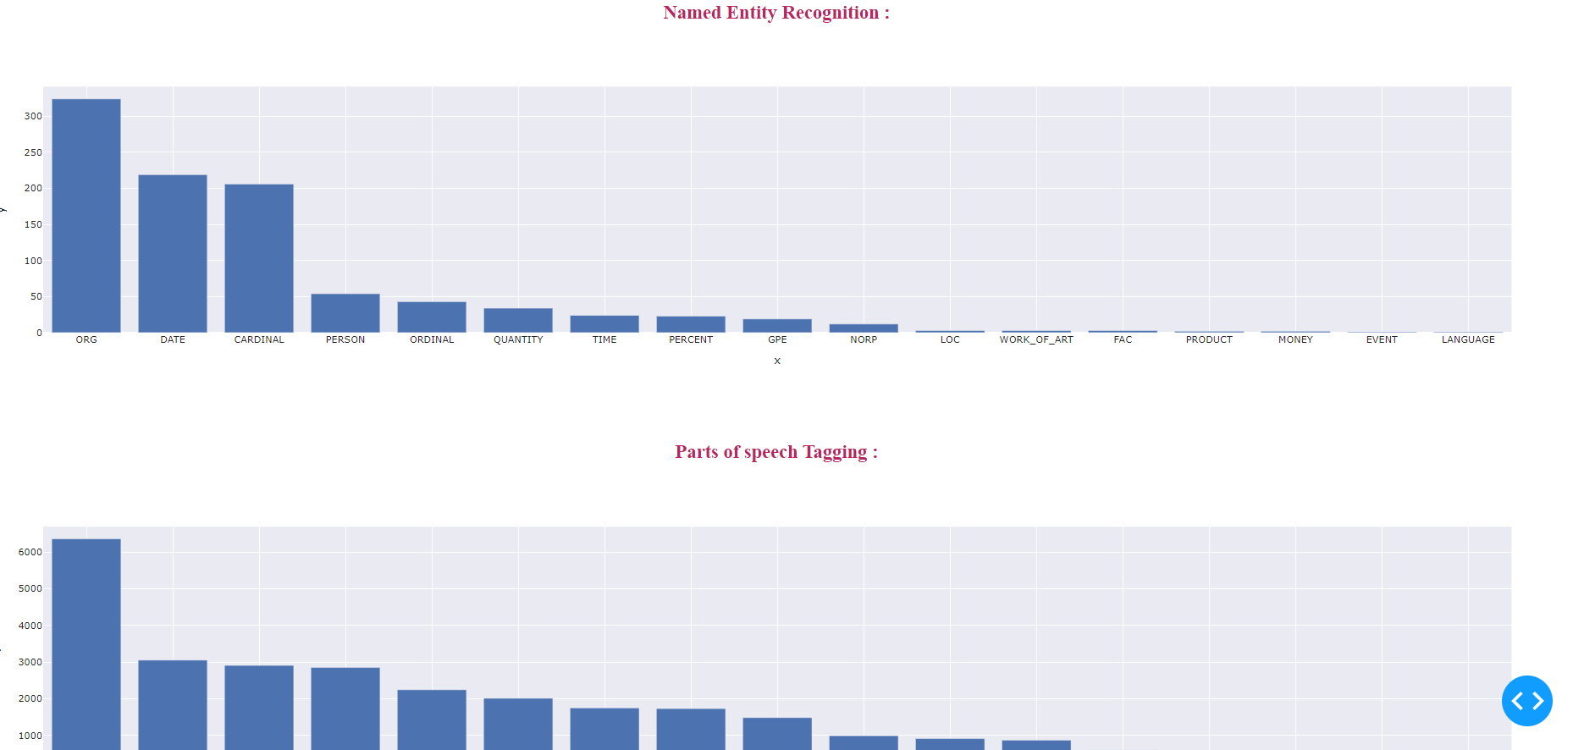

Slide 23
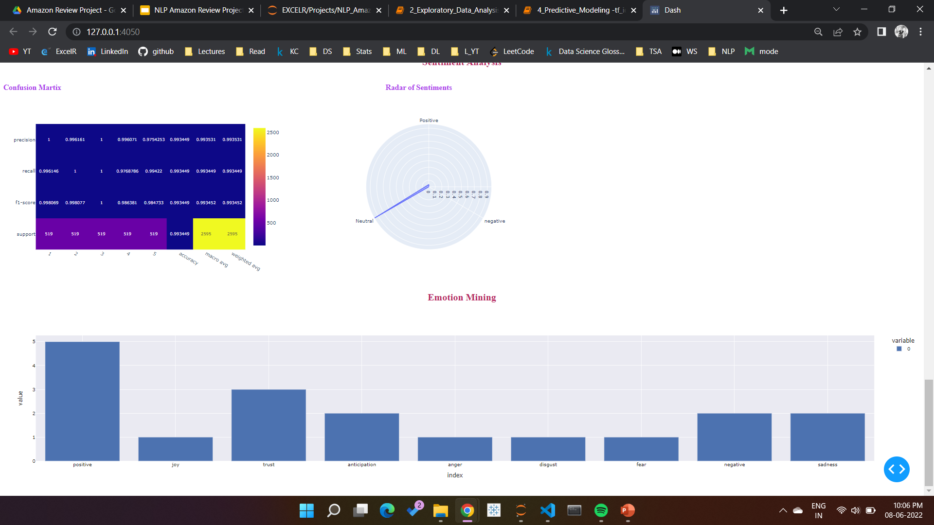

Slide 24
THANK YOU

